Slide 1
Image Scraping & Classification Project
Submitted by: Ajitesh Kumar

Slide 2
Problem Statement:
Images are one of the major sources of data in the field of data science and AI. This field is making appropriate use of information that can be gathered through images by examining its features and details.
The idea behind this project is to build a deep learning-based Image Classification model on images that is scraped from ecommerce website.

Slide 3
Steps:
The task is divided into two phases:
Data Collection: Scraping image data from ecommerce website.
Model Building:
Loading the dataset.
Model building
Performing prediction
Saving the final model

Slide 4
Data Scraping (Phase - 1)
Our dataset contains total 720 images which we’ve scraped from the ecommerce website amazon.in
The clothing categories used in this project are:
Sarees (Women)
Jeans (Men)
Trousers (Men)
So, we have total 3 classes.

Slide 5
Model Building (Phase - 2)
In this phase we worked for the model building to classify the model based on the types.
Following steps we’ve followed:
Loading the data
Training different models
Saving the best model
Performing prediction

Slide 6
Algorithms (models) Used:
We’ve used 3 algorithms to build the model:
VGG16 (tensorflow.keras.applications.vgg16)
ResNet50 (tensorflow.keras.applications)
InceptionV3 (tensorflow.keras.applications.inception_v3)
The best performing model for our dataset is VGG16.

Slide 7
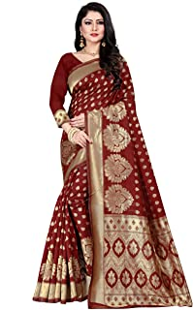
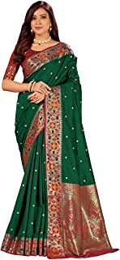
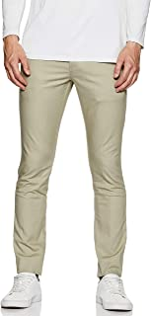
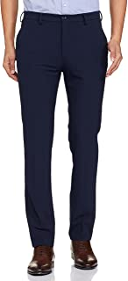
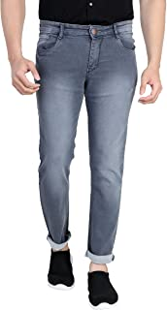
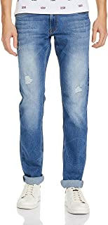
Random Images from the dataset:

Slide 8
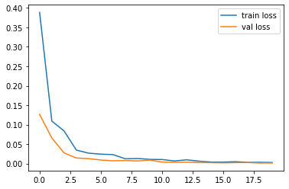
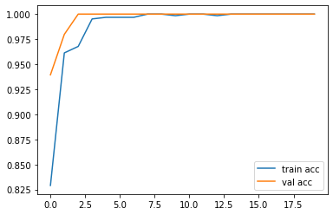
Loss & accuracy on the train and validation set:
Loss
Accuracy

Slide 9
Model Accuracy:
VGG16 - 1.000
ResNet50 - 0.9065
Inception - 0.9048
So, VGG16 is performing best on our dataset. So, our final model is VGG16.

Slide 10
Thank You

